Slide 1
UXiD Final Presentation & Hi-fi Demo { MYSIC }
{ Javen Lai Le Yu }
{ Student id }
{ T17 }
{ CICT (T63) }

Slide 2
1. Mobile App Value Positioning Statement
Mobile App Value Positioning Statement
For | Students - including mild color blind and dyslexic.
Who | Wants a simple, easy-to-use App to enjoy music whenever and wherever they want - even without internet connection.
The | MYSIC App | is a | Free, vibrant and User-oriented music player app
That | allows Users to find, discover and play songs. App provides relevant customizability for User comfortability (dark mode, change wallpaper) along with features like night mode (for night time usage and color blind Users) and Enlarge Mode (easier to read and view, for dyslexic Users).
Notes:
* Sample (For reference only)
For non-tech-savvy movie lovers
who want to check out on movies and their reviews.
The “XYZ Movie Review” is a mobile-based movie info solution
that enables the movie lovers to have an avenue to discover movies.

Slide 3
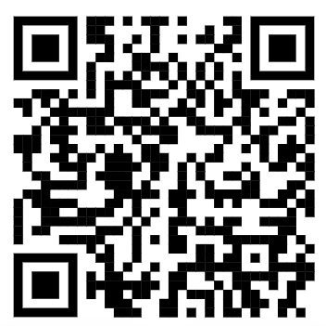
Comparison of Low-fi, HighFi V1 & V2
HTML to compare all Versions:
https://javenuxid.netlify.app/
All 3 Versions are made from Adobe XD, embedded to html.

Slide 4
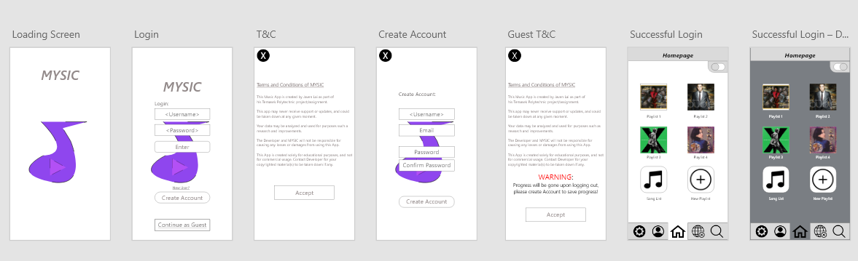
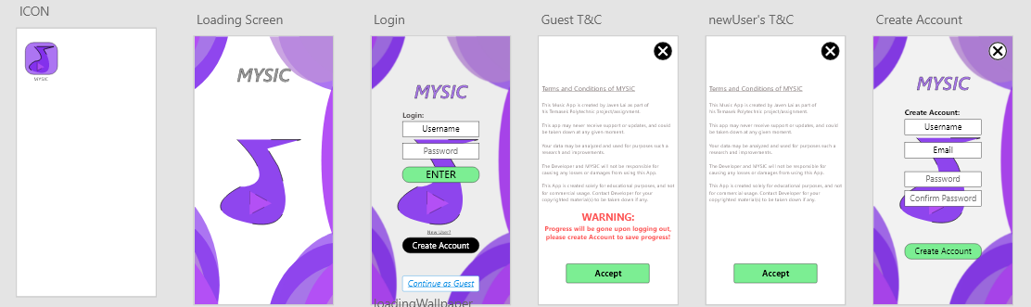
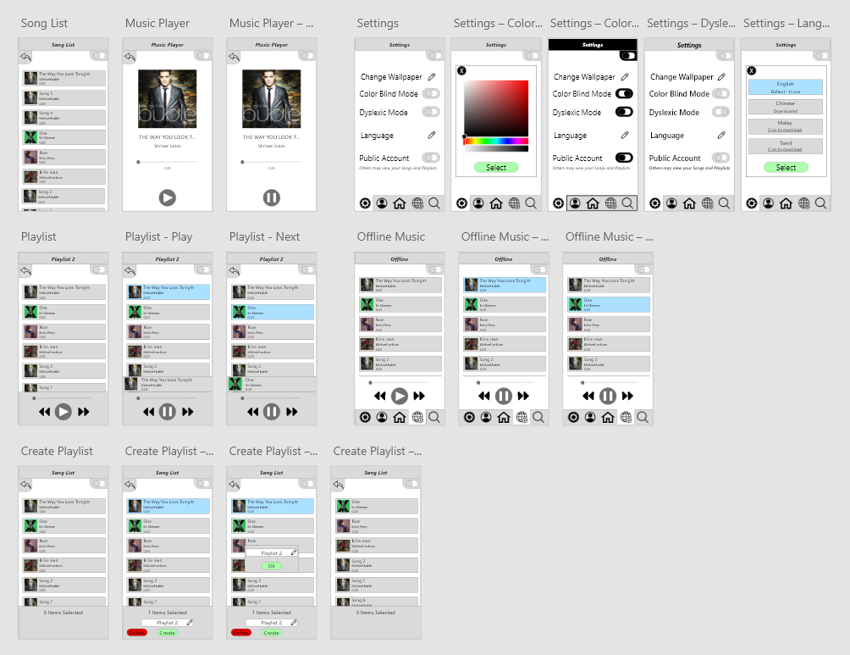
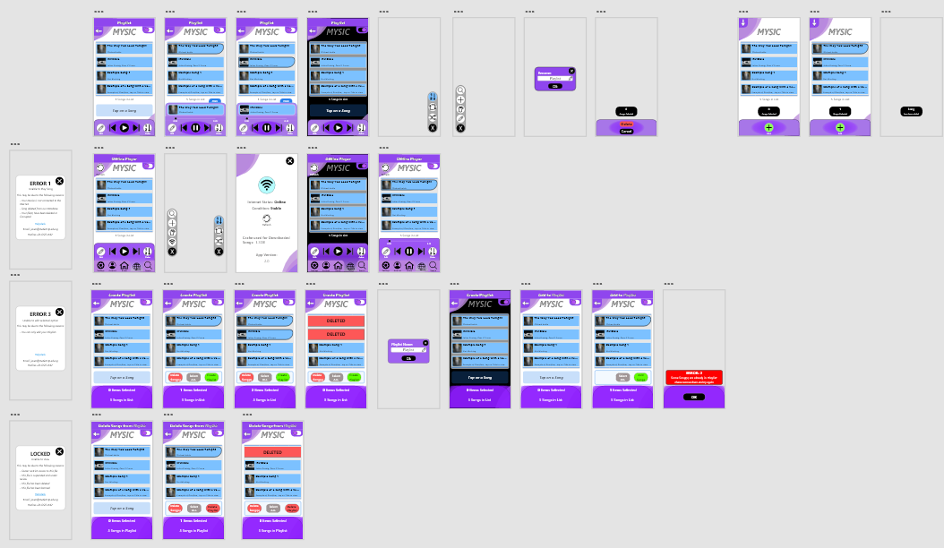
2 Low-fi vs High-Fi
Login, Playlists and Homepage

Slide 5
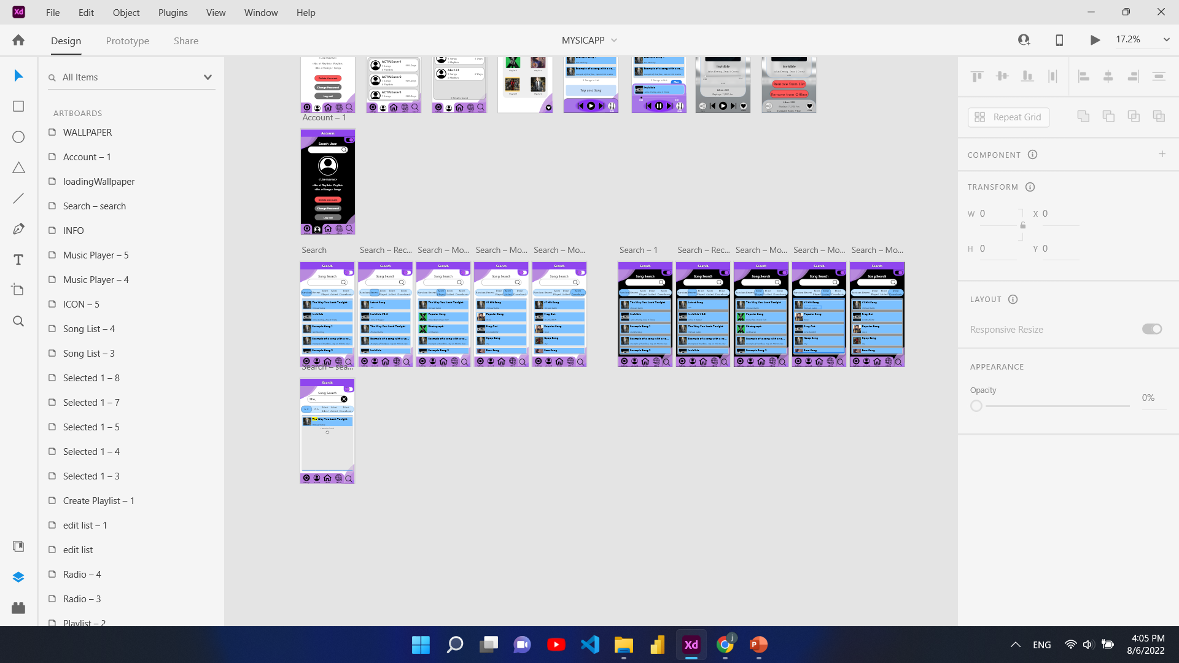
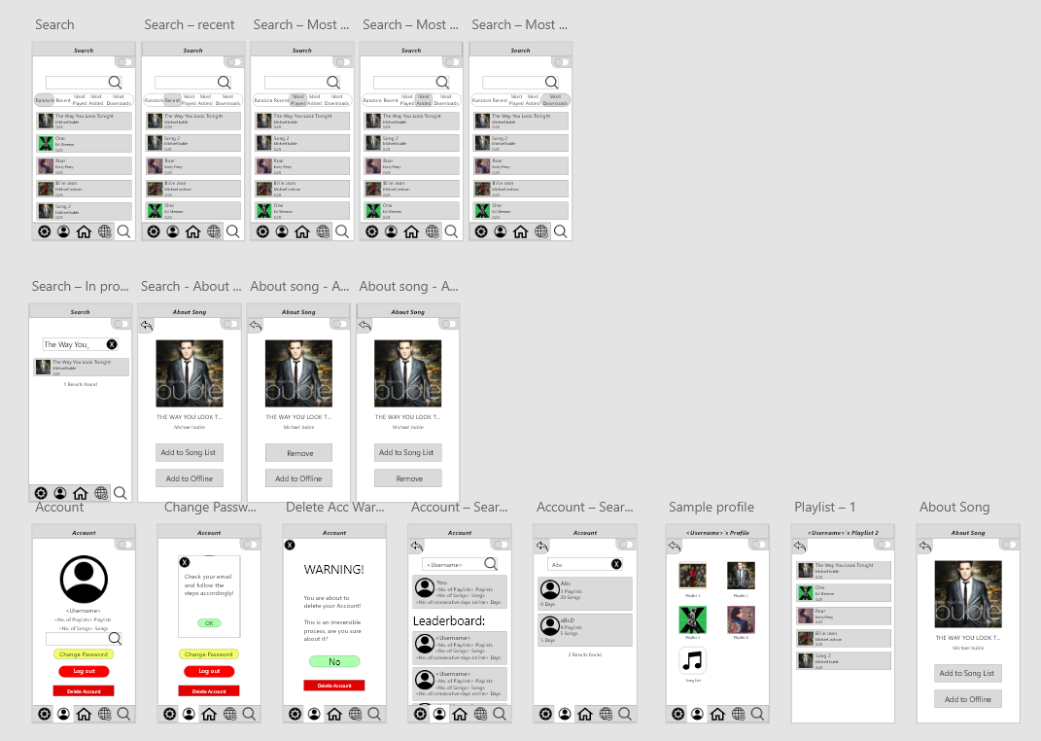
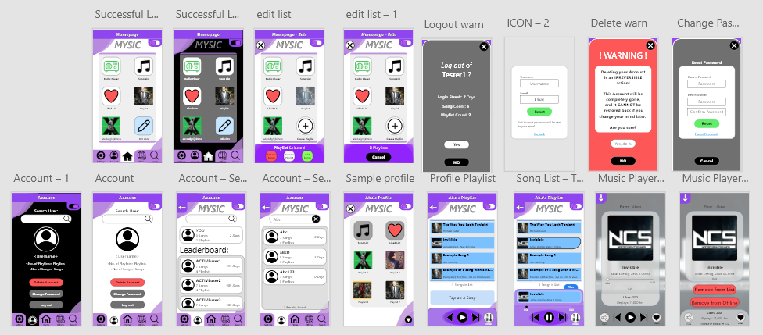
2 Low-Fi vs High-Fi
Search for Song, Account (+Search User) and Music Player

Slide 6
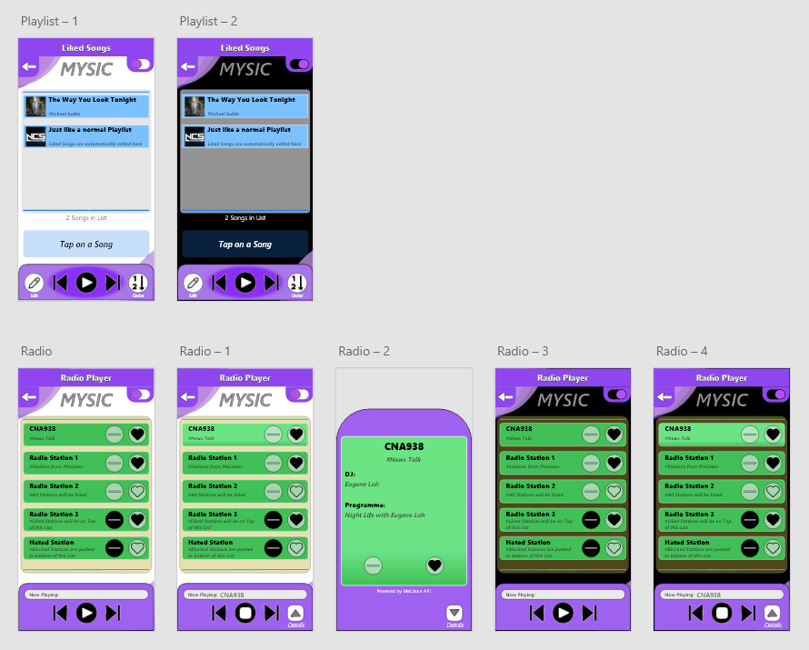
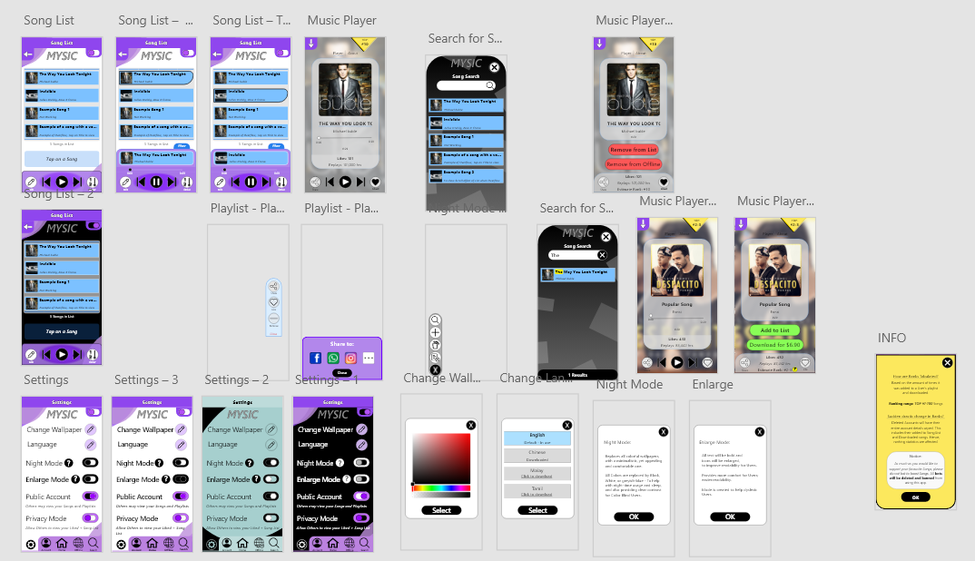
2.2 High-Fi Additional features

Slide 7

4. Video Demo of Hi-Fi Prototype V1.0
Brief Demo Video (4mins):
https://youtu.be/UvuvRYssvmU
Test All Versions:
https://javenuxid.netlify.app/
Full Walkthrough Demo Video (8mins):
https://youtu.be/w5M4f3-2TZI

Slide 8
5. Personal Reflection
Started since June Holidays, constantly improving as new ideas spark. It had been extremely numbing – repetitive cycle of designing a single app from day to night for countless of weeks.
Each time, I thought I was finally completed, however there was always an idea that randomly arises at random times of the day. Hence, constant improvements all the way till submission dateline.
This was when I understood why Apps always update – bugs fixes, new features, UI + Usability improvements… - as there is no perfect app.
I had put myself through all this pain in hopes of getting a favorable grade, hence I hope all my commitment, effort and time spent will not be in vain.
I rate this experience 3/5 (Neutral)
Notes:
Experience? (Positive/Negative)
What new things did you discover/learn through this assignment?
What do you enjoy most?
Now, rate your experience from this whole assignment. (1 – poor, 2 below average, 3 average, 4 - good, 5 - excellent)

Slide 9

Thank You !

